Slide 1


Slide 2
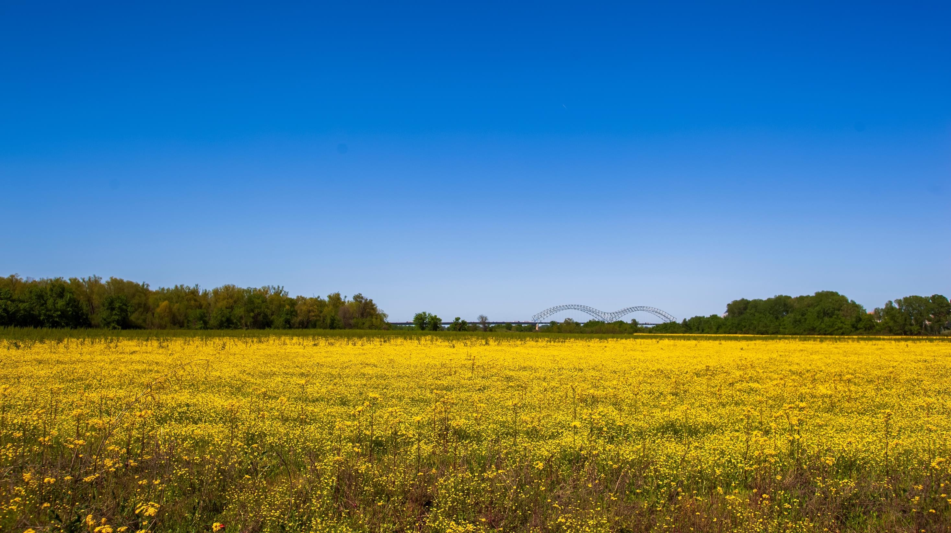
The Mid-South Delta will lead innovative agriculture value-chain development by leveraging our ideal growing conditions, abundant natural resources, local expertise, industrial assets, and world-class distribution.

Slide 3

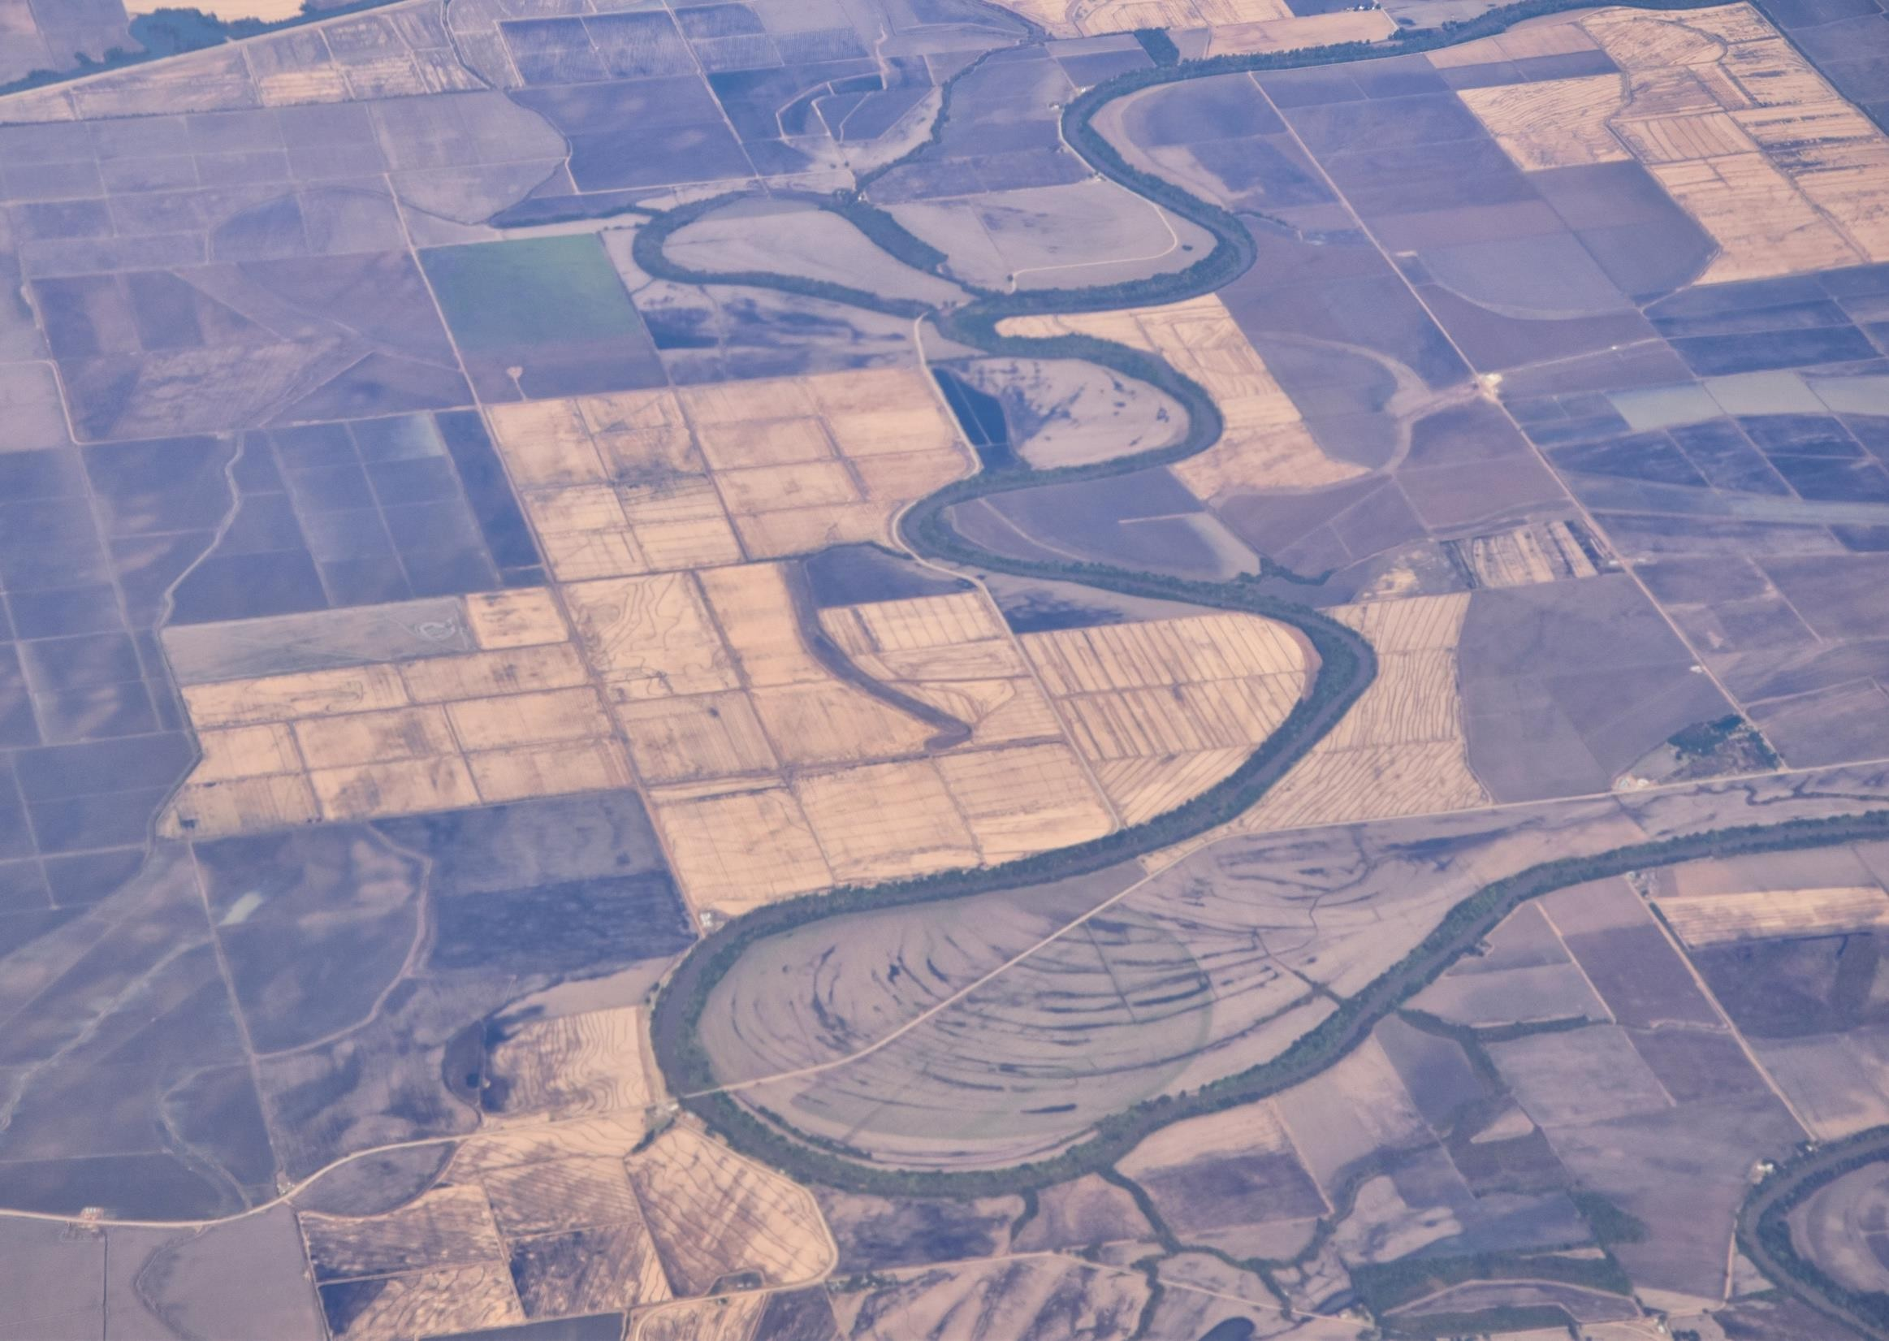
The Region.
16M arable acres Access to water Public R1 University
Regional research farms World class logistics
250 Food C Beverage Companies

Slide 4
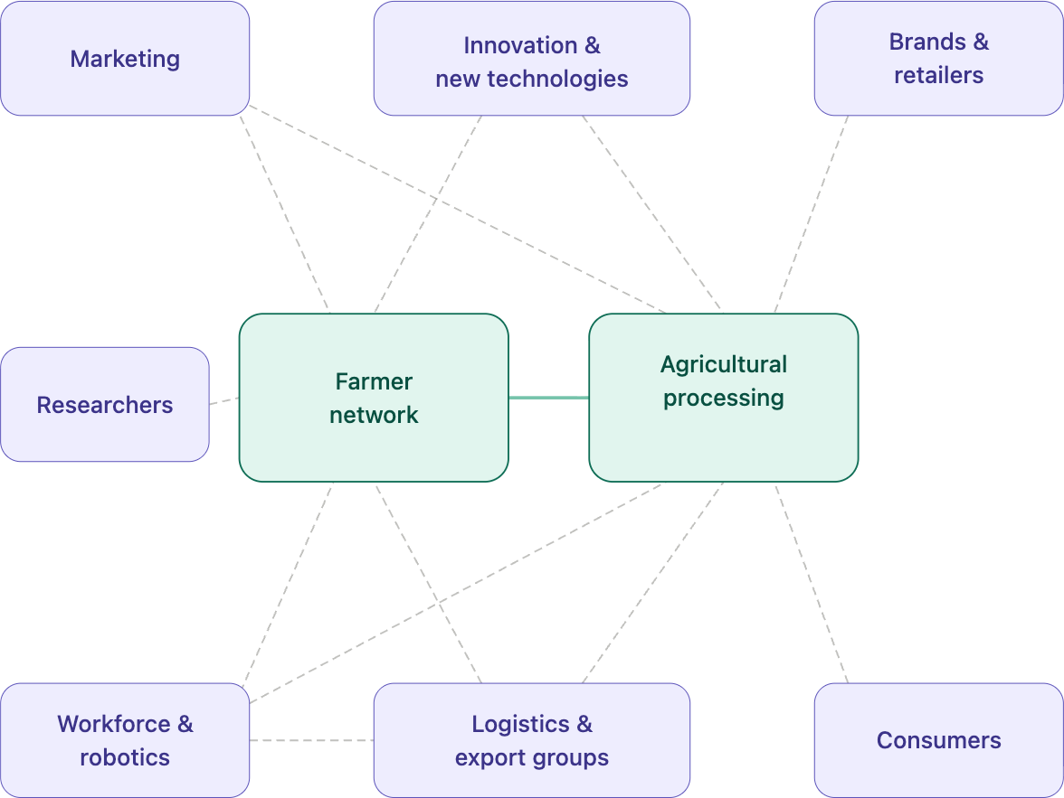
Strategic Priority for our Cluster
Establish a framework to efficiently assess agronomic and market opportunities for new crops and products

Slide 5
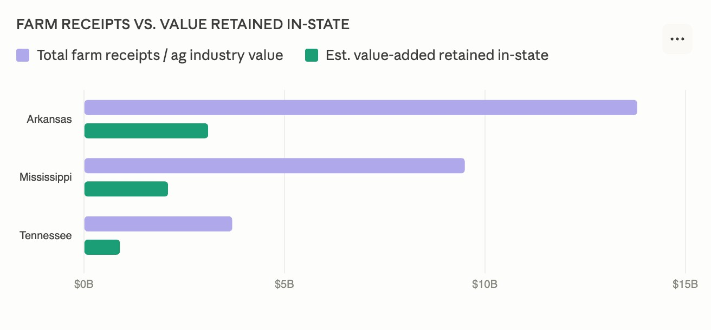

The gap between raw grain and isolate represents ~8× more value per ton: margin that currently accrues
to processors outside the region.

Slide 6




Jobs created per ton: specialty tomatoes
Labor hours per ton of raw production | Small-to-mid scale, hand-harvested fresh market
The multiplier effect
Logistics
4
2.4x
more jobs with local processing
Farm gate only
25
→
Full value chain
Value-added products
20
hrs / ton
Processing
10
59
hrs / ton
Production
25
0
5
10
15
20
25
30
Production: 25 hrs
Processing: 10 hrs
Value-added: 20 hrs
Logistics: 4 hrs
Sources: UC Davis, UF IFAS, Univ. of Missouri Extension, USDA ERS. Fresh market, hand-harvested at ~15 tons/acre. FTE = 2,000 hrs/yr.

Slide 7
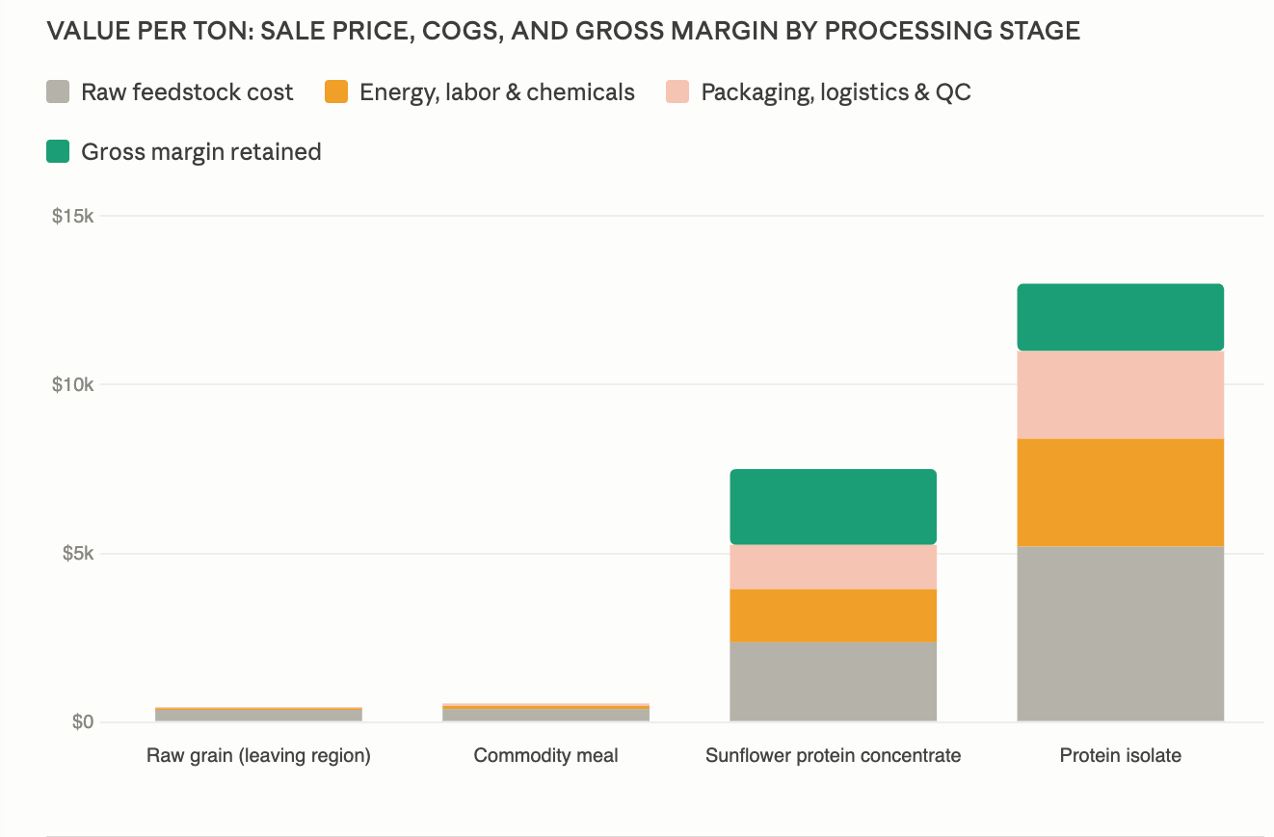

Slide 8


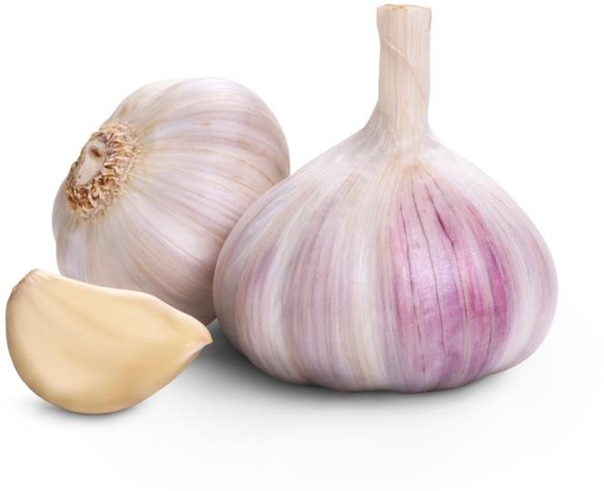
Why this priority: Memphis is ready to rock and roll
Anchors already working on these initiatives
Stress test -> sunflower, garlic, tomato
We have the agricultural infrastructure, but we are not retaining the value in the region
Cross-sector collaboration
Coordinated effort that builds a strong ecosystem

Slide 9

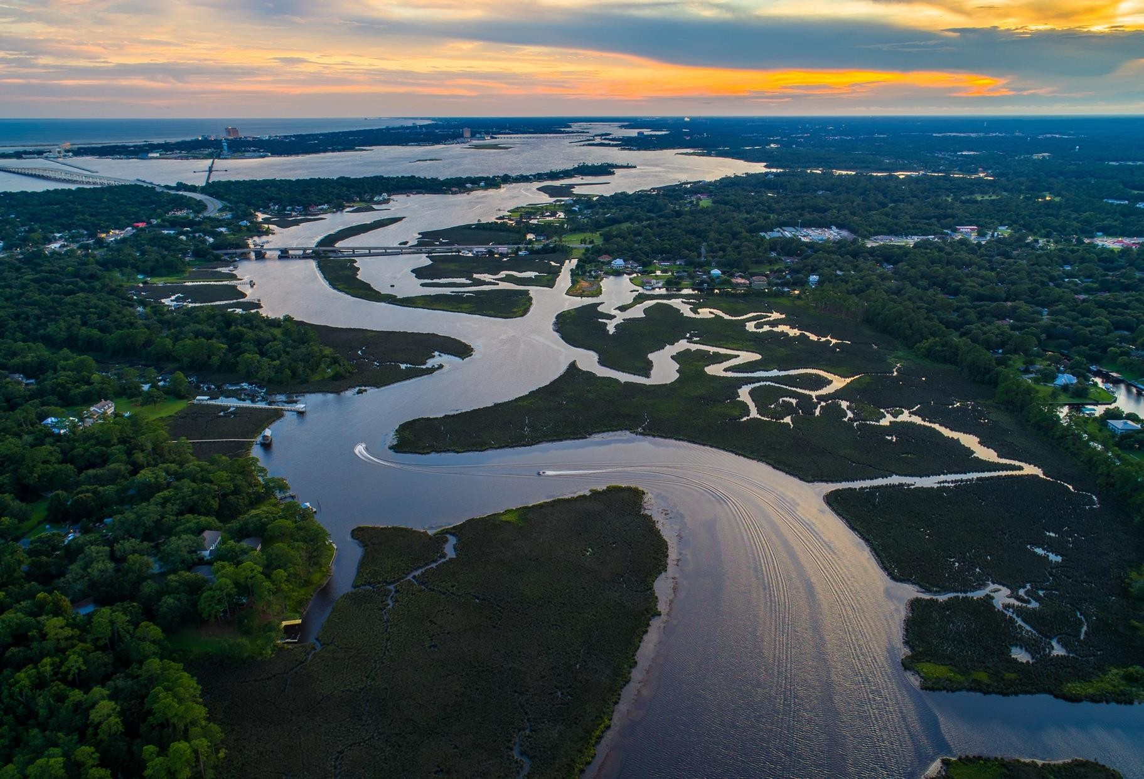
12-month plan
Identify an individual to lead
Identify anchor institutions including farmers
Identify food C beverage sourcing needs
Inventory industrial assets
Enhance on-farm research capacity
90-day activation agenda
Launch new crop opportunity assessment tool, AgLaunch
Explore a host institution for the new cluster, MDD
Identify funding sources to establish the new cluster organization, The Cluster
Establish a follow-up cadence, The Cluster
How will we get there?

Slide 10
Cluster Metrics
Size of the cluster; new partners
Employment in the cluster; direct and indirect
# New and activated processing and production facilities # New research projects
# New opportunities evaluated
% Acres converted by 2031

Slide 11

It’s a slam dunk.

